Slide 1

NBA Player of The Week
Adam Griffith, Gabrellea Norman, Nick Remen, Roberto Gutierrez

Slide 2
Project Overview
To begin, we loaded in a dataset that collected NBA Player of the Week data from the 1978 - 2020 NBA seasons.
When analyzing the data, there were a couple questions we wanted to answer:
Who are the most successful players and teams?
Does age play a part in a players chances of winning Player of the Week.
Which positions have won Player of the Week the most?
How has the average height of Player of the Week winners changed over time?
What were the top draft classes to produce NBA Players of the Week?

Slide 3

What are the most successful players and teams?

Slide 4

Who are the best players?
This data compares the number of times the best players in the NBA won the Player of the Week award. These players were selected because they all won the award at least twelve times, indicating a sustained period of time where they were considered to be one of the best players in the NBA. If we were to only consider this metric, LeBron James would be the best player in the NBA. All of the top players demonstrated a high level of play over a long period of time. The flaw in this methodology may be that players with shorter careers will be placed at a disadvantage.

Slide 5
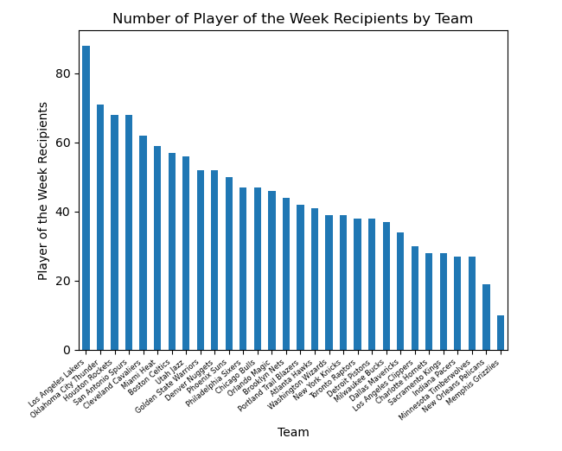
Who are the best teams?
This graph was calculated by determining how many times a player on a specific team won Player of the Week. The Los Angeles Lakers had the most Players of the Week by a significant margin. All of the best teams had at least one player on the “best players” chart play on that team for a significant amount of time. The Lakers, for example, had Kobe Bryant, Shaquille O’Neal, LeBron James, and Magic Johnson play for that team for a significant amount of time. Some of the worst teams, such as the New Orleans Pelicans or Memphis Grizzlies, played their inaugural seasons after the data had started to be collected, which may be a flaw in using this method to gauge team success.

Slide 6
What is the average age of NBA players who won player of the week per season?

Slide 7
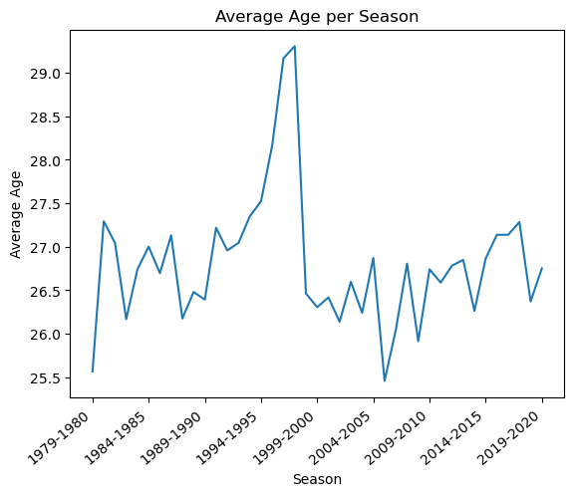
Average Age Per Season
The results in the line chart indicates that the average age of players who won were from 25 -29 years old, from 1979 -2020. The average age of NBA players who won player of the week hit a peak at the age of 29 for NBA Season 1996-1998. While NBA Season 1979-1980 and 2005-2006 average age was around 25.

Slide 8
Does having less experience in the league increase the chances of receiving NBA Player of the week?

Slide 9
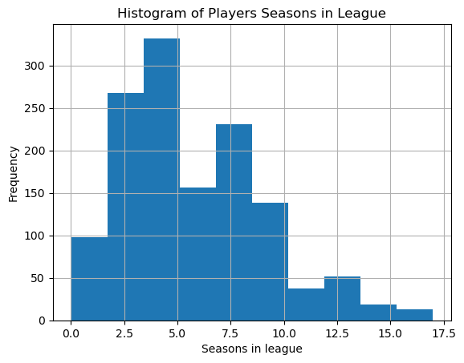
Seasons In League
The histogram determined that there was an increase in frequency between 0 to 5 seasons in the league, with the highest frequency of NBA Players of the week at the 5th season. After 7 seasons in the league As the number of seasons in the league started to increase the frequency of NBA Players of the Week started to decrease.

Slide 10
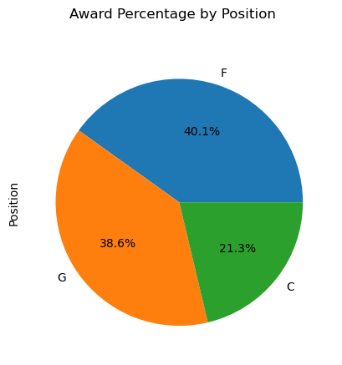
Which position won the most Player of the week awards?
To the right we see a breakdown of the winners of Player of the week by position. We see that Guards and Forwards are the most awarded positions but it should be worth noting that originally the data listed 11 unique positions and it was decided it would be best for our purposes to consolidate the positions as G,F,C. Ideally, we would have had 5 unique values for the positions but now let’s look at how the average height has changed per season

Slide 11
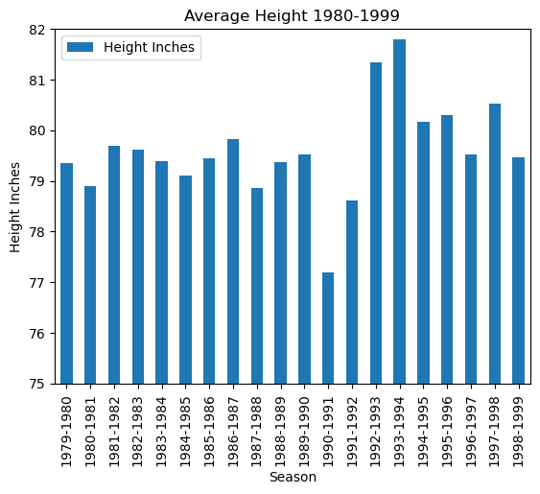

Average Height of winners 1980-1999
Plotted we can see the average height of the winners from 1980-1999. From the chart we can see that that the average height spikes down to about 77 inches in the 1990-1991 season and spike up to almost 82 inches in the 1993-1994 season. Afterwards we see they begin to steadily decline. When looking at sharp spike from 1992 to 1993 I wondered what could be the reason for such a sharp spike ? The answer was the arrival of players like Shaquille O’Neal and Alonzo Mourning who had immediate impact on the league as a whole. The average height of all winners was 79.2 inches

Slide 12
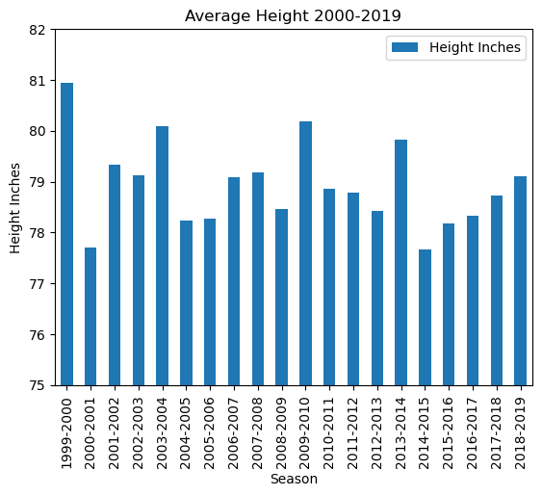


Average Height of Winners between 2000-2019
To the right we see the average heights for 2000-2019 and we see that the average heights go through cycles rising and falling. The average height of winners for 2000-2019 was 78.9 inches a slight decrease from the previous twenty years which was 79.6 inches. The tallest players to win the award was Yao Ming standing at 90 inches and the shortest player to win was Isaiah Thomas standing at 69 inches.

Slide 13
What are the limitations?
One of the problems with the dataset was that it was not inclusive of all players in the NBA and thus the average height from earlier does not necessarily reflect the trend of the NBA
Additionally the data only includes data from the last 40 years with no data available from 1946-1978 as the POTW award had not been created.

Slide 14

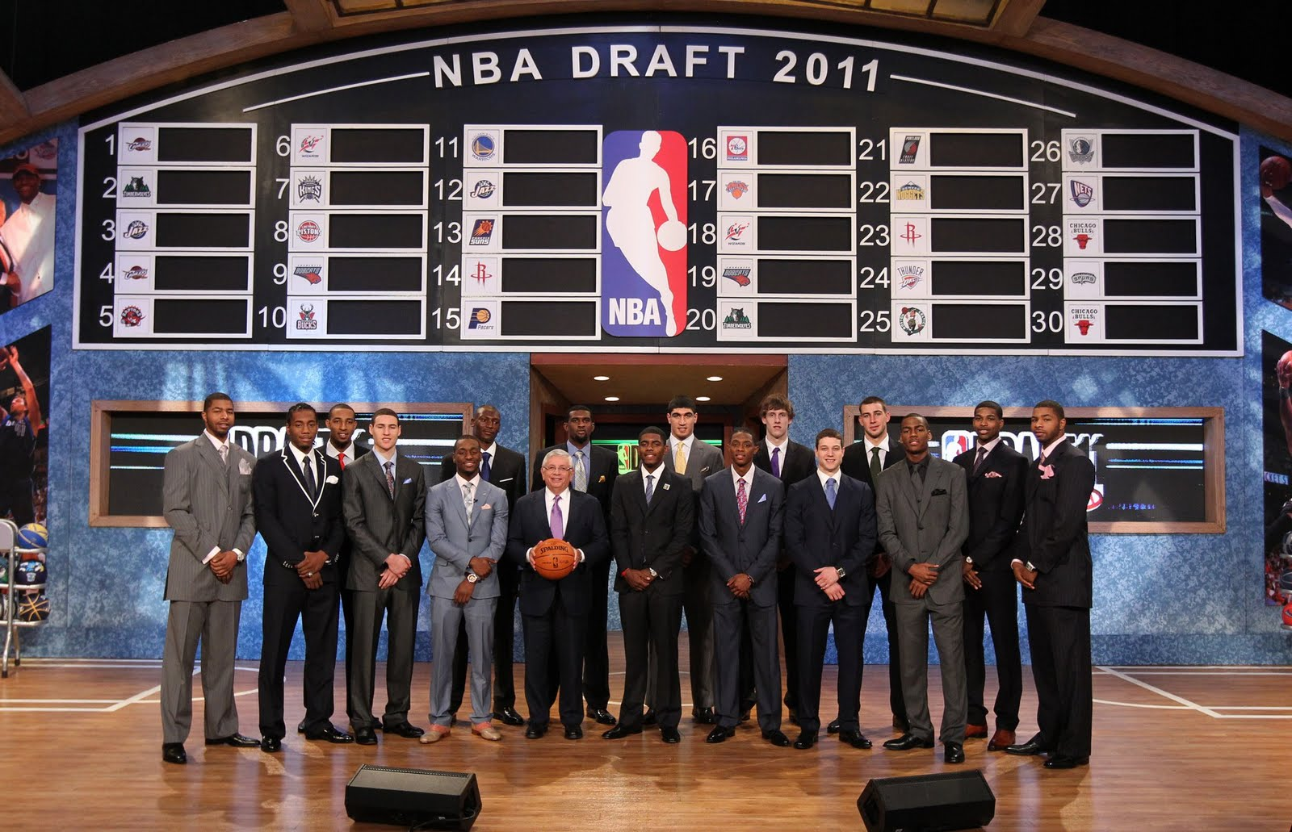
Do the top draft classes tend to have depth or top end talent?

Slide 15
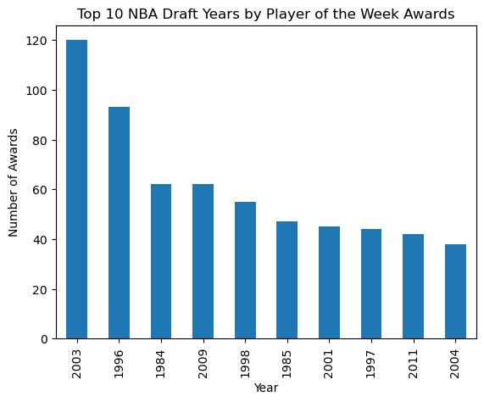
Top 10 Draft Classes
To first figure out if top end talent mattered more than draft depth, it was important to figure out the top draft classes within the data.
As shown in the graph, the top 5 draft classes were 2003, 1996, 1984, 2009, and 1998.
gender_plot = cleaned_df["Sex"].value_counts()
gender_plot.plot.pie(autopct = "%1.1f%%")
plt.showgender_plot = cleaned_df["Sex"].value_counts()
gender_plot.plot.pie(autopct = "%1.1f%%")
plt.show()

Slide 16
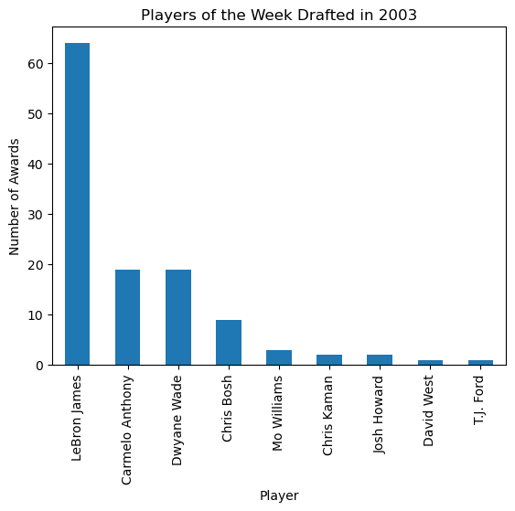
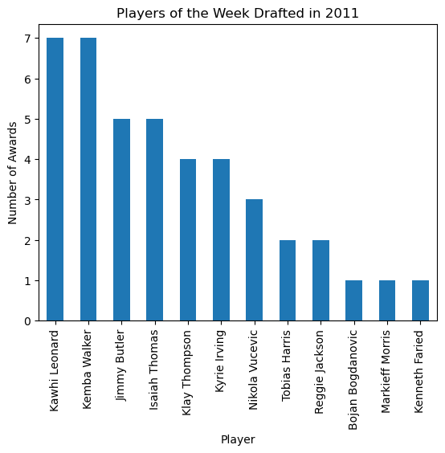
Top End Talent Vs Depth
The graph below shows the players that were drafted in 2003, and the number of POTW awards they have won throughout their career. 2003 had Lebron James, who won the most POW awards overall.
The graph below shows the players that were drafted in 2011, and the number of POTW awards they have won throughout their career. 2011 was the only draft in the top 10 that did not have a player win double digit POW awards.

Slide 17
After looking at all of the draft years individual graphs, it is clear that both depth and top-end talent are important. Each draft class within the top 10 had depth, but only classes with elite top-end talent were propelled into the top 5.

